Slide 1
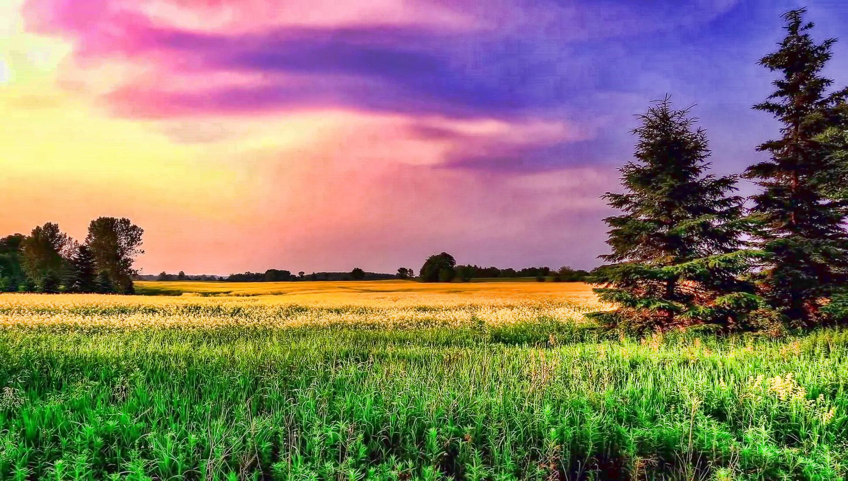
Agricultural-Information-Management-System
Aryan Virdi & Lorenzo Resendez
CSE-111: Database Systems

Slide 2
The System
Repository (database) of field operations and statistics.
Logging of crops and their terms, as well as soil samples
Provides windows of information for the user to view.
Supports decision-making of farmers and agronomists
Built in both C++ command-line-interface and HTML/JavaScript

Slide 3
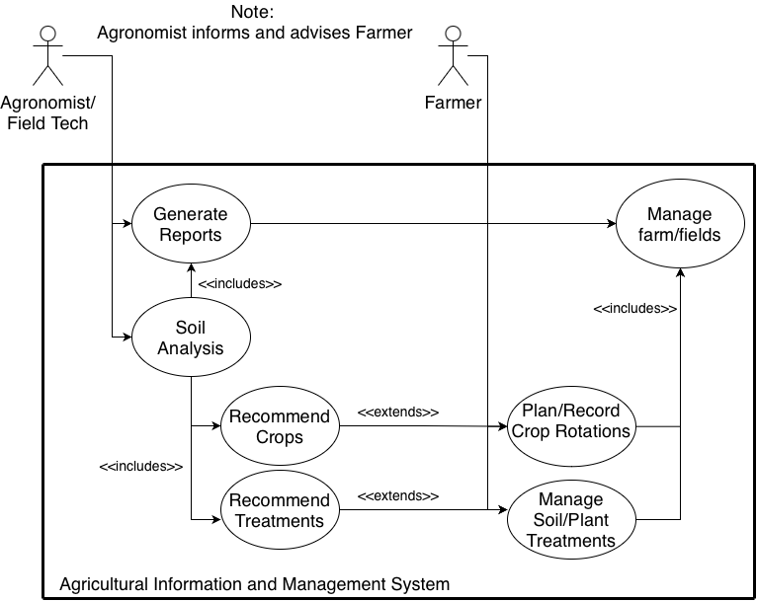
Use cases
Log terms for crops
Log soil samples
View fields’ statistics
Make analyses and reports
Make decisions for the future

Slide 4
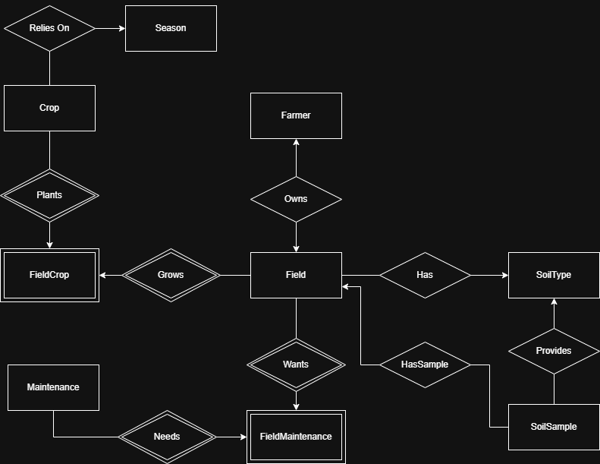
E/R Diagram

Slide 5
Relational Schema I
Farmer(FarmerID, FieldID, FirstName, LastName)
Field(FieldID, FarmerID, SoilTypeID)
SoilType(SoilTypeID, SoilTexture, AvgSand, AvgSilt, AvgClay)
SoilSample(SoilSampleID, FieldID, Date, SandPct, SiltPct, ClayPct,
pH, N, P, K, OM, CEC, [Heavy Metals], Comments)
Crop(CropID, Name, SciName, daysToMature, preferredSeason, preferredSoil
preferre_pH, GermRate, NutrientUse)
Season(SeasonID, SeasonName, StartDate, EndDate)
Maintenance(MaintenanceID, Category, Name, ApplicationDate, ActiveIngredient, Notes)

Slide 6
Relational Schema II (Many-Many)
FieldCrop(FieldID, CropID, seasonID, beginDate, endDate, yield,
Units)
FieldMaintenance(FieldID, MaintenanceID, Concentration, Units,
Amount, BeginDate, EndDate)

Slide 7
Implementation
Database: SQLite
Generated template for CLI application with ChatGPT.
Fitted our queries into this interface.
Translated the CL interface (with ChatGPT…) into HTML-CSS-JavaScript web application.

Slide 8
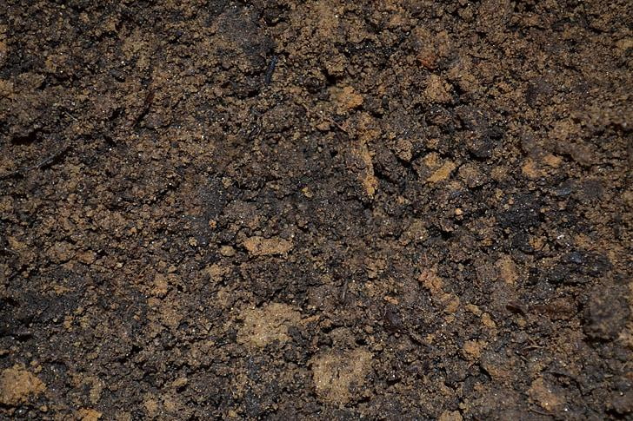
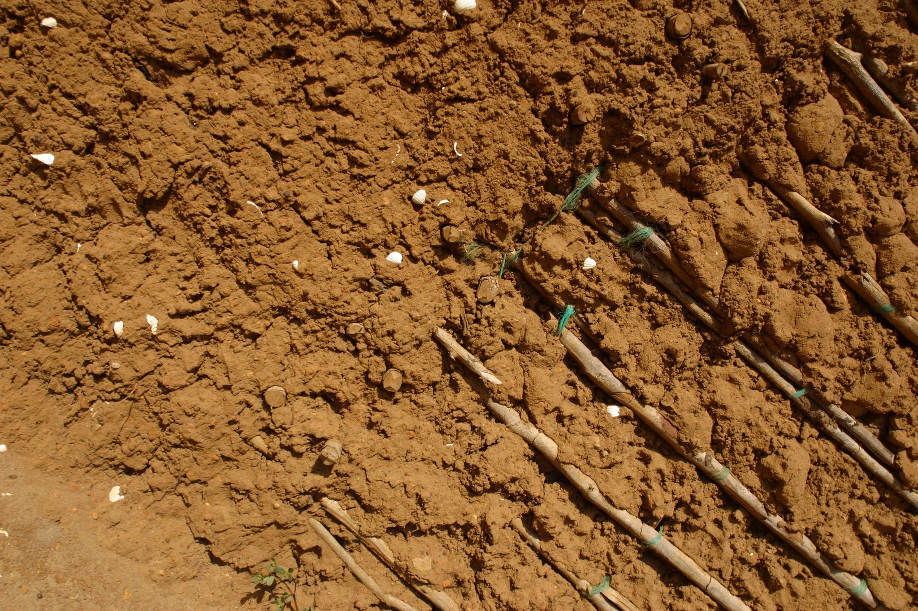
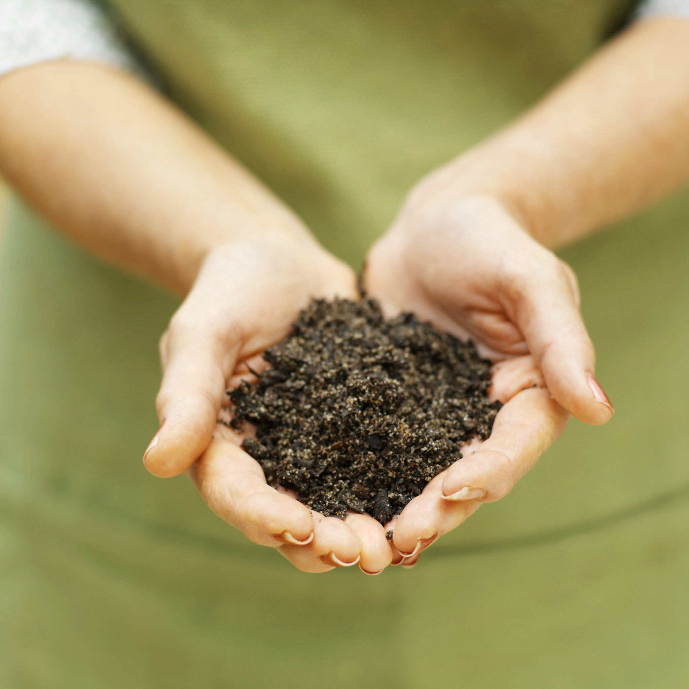
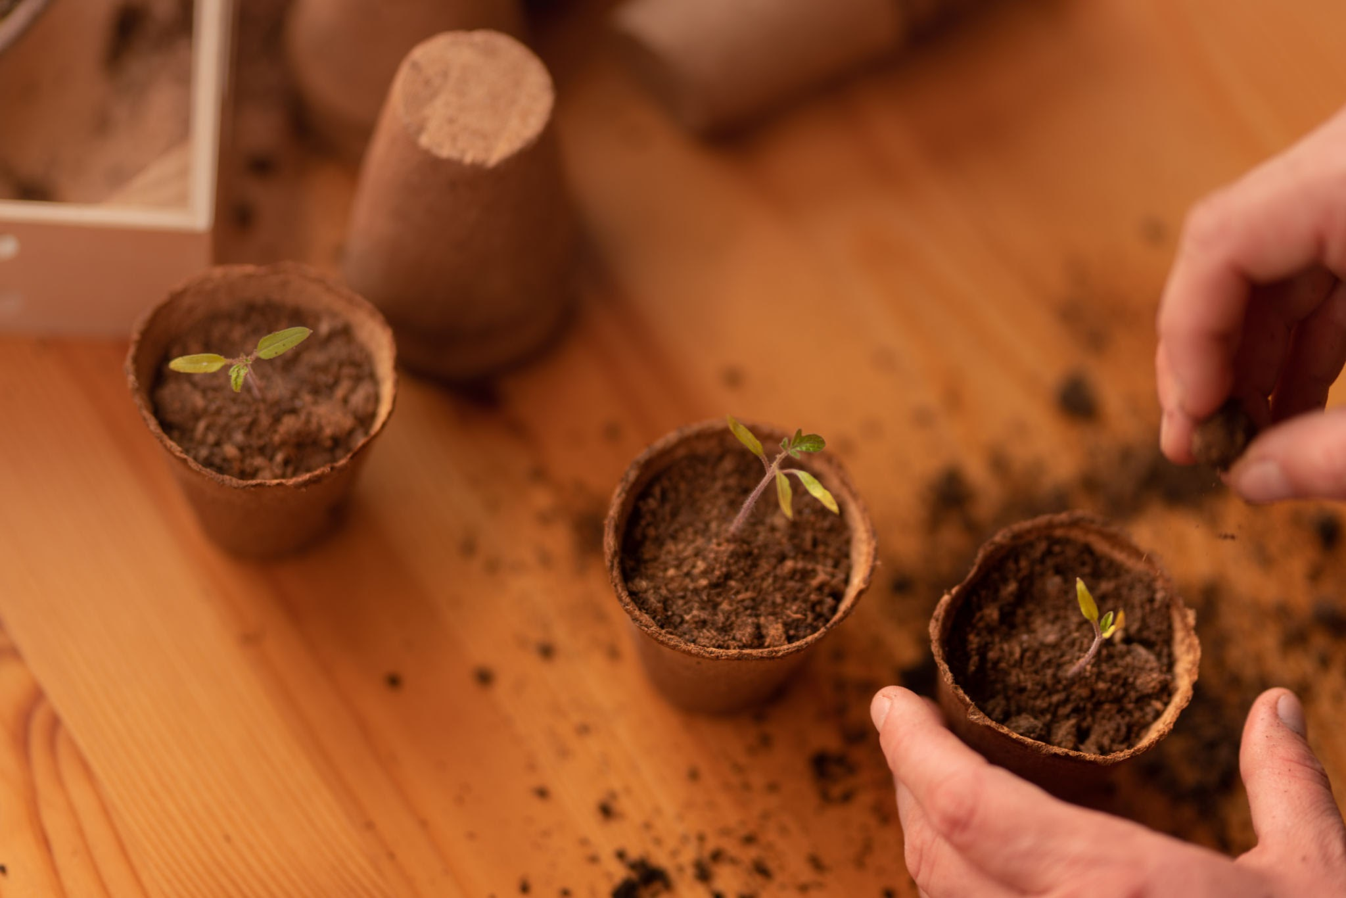
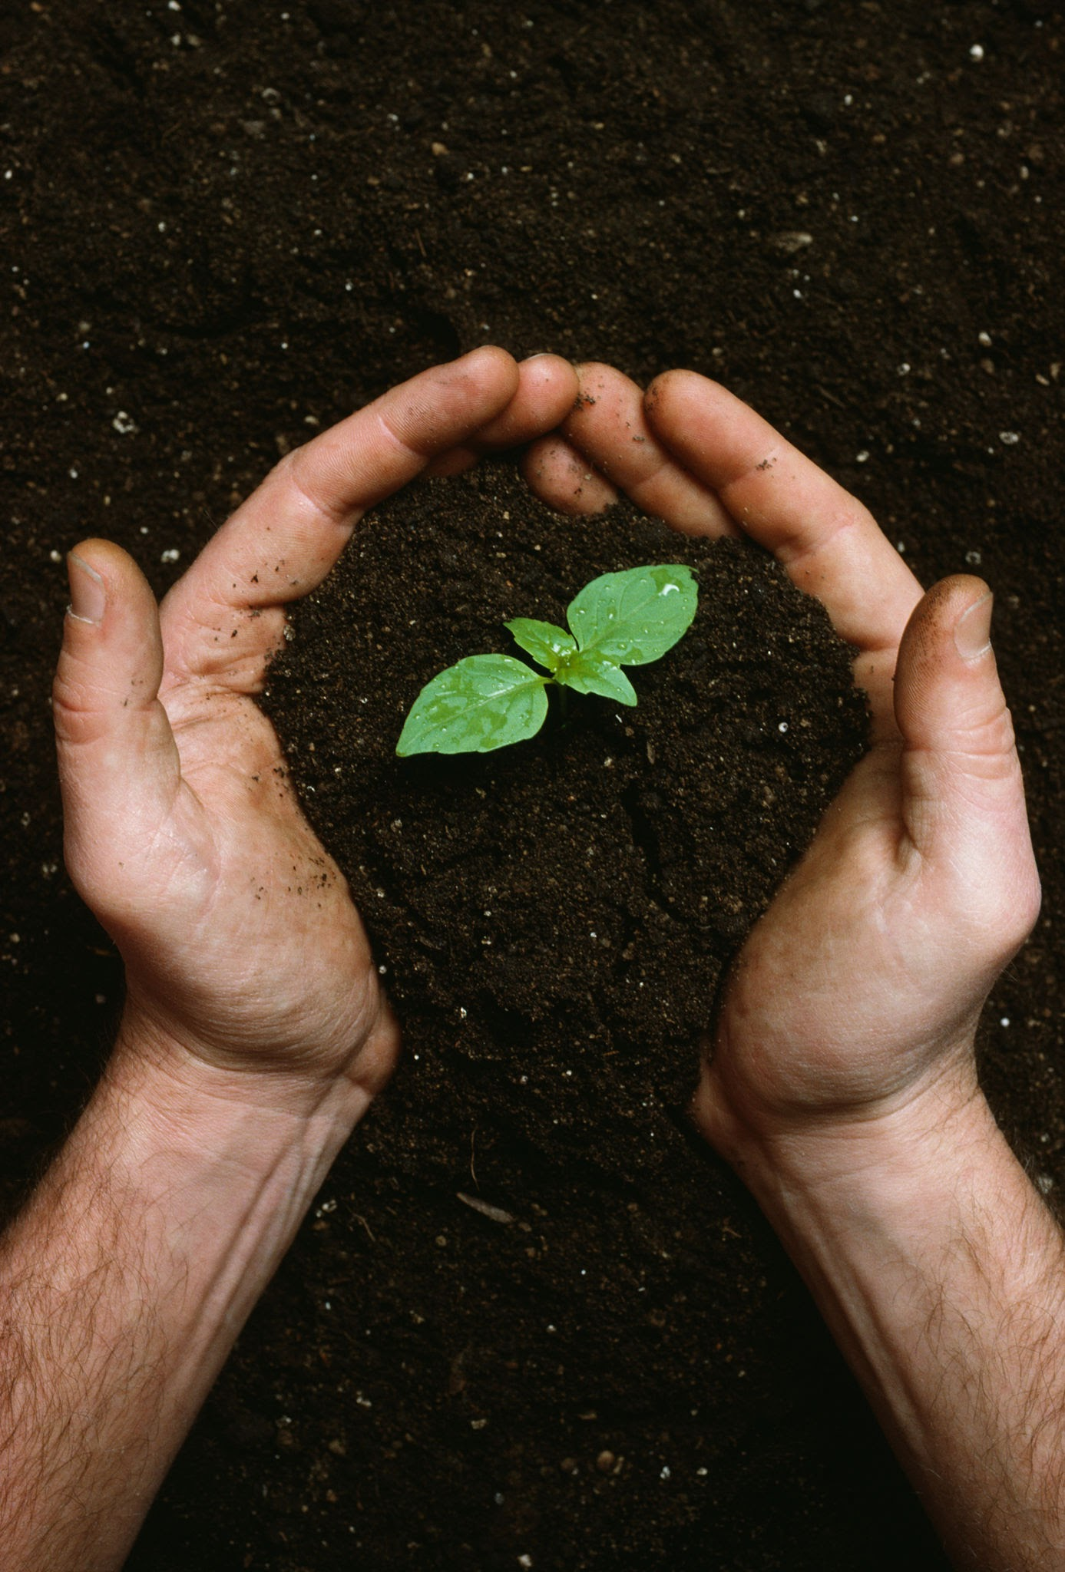
A.I.M.S
A database for agricultural optimization.

